Slide 1
Structure Programming
ICT-1105
Information and Communication Technology
Lecture-06
Date:

Slide 2
Class contents has given in Google Classroom with code
nhauiw4

Slide 3
VARIABLES
A variable is a name of memory location. It is used to store data. Variables are changeable, we can change value of a variable during execution of a program. . It can be reused many times.
A data type is associated with each variable & it decides what values the variable can take.

Slide 4
VARIABLES
When you decide your program needs another variable, you simply declare (or define) a new variable and C makes sure you get it.
You declare all C variables at the top of whatever blocks of code need them.
Variable are nothing but identifiers.

Slide 5
Rules to write variable names
A variable name contains maximum of 30 characters/ Variable name must be up to 8 characters.
A variable name includes alphabets and numbers, but it must start with an alphabet.
It cannot accept any special characters, blank spaces except underscore( _ ).
It should not be a reserved word.

Slide 6
Rules to write variable names
A variable name contains maximum of 30 characters/ Variable name must be up to 8 characters.
A variable name includes alphabets and numbers, but it must start with an alphabet.
It cannot accept any special characters, blank spaces except underscore( _ ).
It should not be a reserved word.
Ex : i rank1 MAX min Student_name
StudentName class_mark

Slide 7
Declaration of Variables
A variable can be used to store a value of any data type. The declaration of variables must be done before they are used in the program.
There are two places where you can declare a variable:
1. After the opening brace of a block of code (usually at the top of a function)
2. Before a function name (such as before main() in the program)

Slide 8
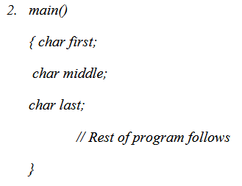
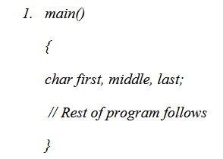
Declaration of Variables
Suppose you had to keep track of a person's first, middle, and last initials. Because an initial is obviously a character, it would be prudent to declare three character variables to hold the three initials. In C, you could do that with the following statement:

Slide 9
Declaration of Variables
The general format for declaring a variable:
Syntax : data_type variable-1,variable-2,------, variable-n;
Variables are separated by commas and declaration statement ends with a semicolon.
Ex : int x,y,z;
float a,b;
char m,n;

Slide 10
Assigning values to variables
values can be assigned to variables using the assignment operator (=). The general format statement is :
Syntax : variable = constant;
Ex :
x=100;
a= 12.25;
m=‘f’;

Slide 11
Initialization of Variables
When a variable is declared, it contains undefined value commonly known as garbage value. If we want we can assign some initial value to the variables during the declaration itself. This is called initialization of the variable.
Ex:
int pageno=10;
char grade=’A’;
float salary= 20000.50;

Slide 12
Types of Variables
There are many types of variables in c:
1. local variable
2. global variable
3. static variable

Slide 13
Formatted and Unformatted Console I/O Functions
Input / Output (I/O) Functions :
In ‘C’ language, two types of Input/Output functions are available, and all input and output operations are carried out through function calls. Several functions are available for input / output operations in ‘C’. These functions are collectively known as the standard i/o library.

Slide 14
Formatted and Unformatted Console I/O Functions
Input: In any programming language input means to feed some data into program. This can be given in the form of file or from command line.
Output: In any programming language output means to display some data on screen, printer or in any file.

Slide 15
Formatted and Unformatted Console I/O Functions
The Standard Files:
C programming treats all the devices as files. So devices such as the display are addressed in the same way as files and the following three files are automatically opened when a program executes to provide access to the keyboard and screen.

Slide 16
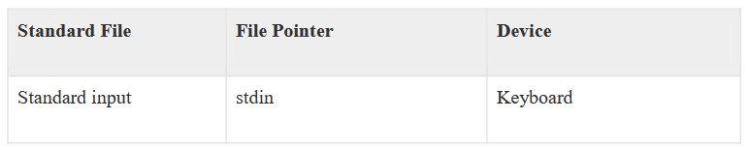
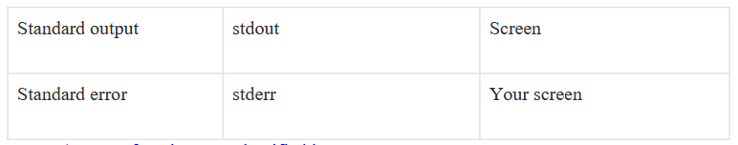
Formatted and Unformatted Console I/O Functions
The Standard Files:

Slide 17
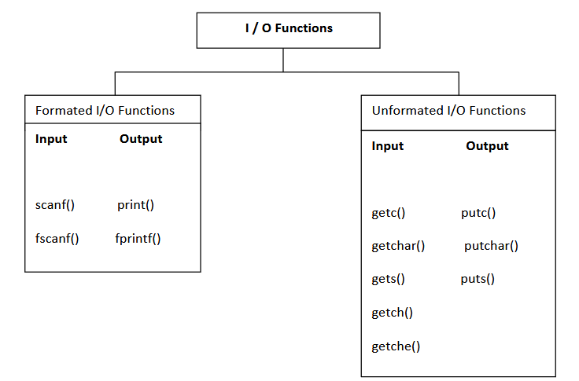
Formatted and Unformatted Console I/O Functions
Input / Output functions are classified into two types

Slide 18
Formatted and Unformatted Console I/O Functions
Formated I/O Functions :
Formatted I/O functions operates on various types of data.
1 : printf() : output data or result of an operation can be displayed from the computer to a standard output device using the library function printf(). This function is used to print any combination of data.
Syntax : printf(“control string “, variable1, variable2, -----------, variablen);
Ex : printf(“%d”,3977); // Output: 3977

Slide 19
Formatted and Unformatted Console I/O Functions
Formated I/O Functions :
printf() statement another syntax :
Syntax : printf(“fomating string”);
Formating string : it prints all the character given in double quotes (“ “) except formatting specifier.
Ex : printf(“ hello “);-> hello
printf(“a”); -> a
printf(“%d”, a); -> a value
printf(“%d”); -> no display

Slide 20
Formatted and Unformatted Console I/O Functions
#include <stdio.h> //This is needed to run printf() function.
int main()
{
printf("C Programming"); //displays the content inside quotation
return 0;
}
Output:
C Programming

Slide 21
Formatted and Unformatted Console I/O Functions
Explanation:
Every program starts from main() function.
printf() is a library function to display output which only works if #include<stdio.h>is included at the beginning.
Here, stdio.h is a header file (standard input output header file) and #include is command to paste the code from the header file when necessary. When compiler encounters printf()function and doesn't find stdio.h header file, compiler shows error.
return 0; indicates the successful execution of the program.

Slide 22
Formatted and Unformatted Console I/O Functions
Input- Output of integers in C
#include<stdio.h>
int main()
{
int c=5;
printf("Number=%d",c);
return 0;
}
Output
Number=5

Slide 23
Formatted and Unformatted Console I/O Functions
Input- Output of integers in C
Inside quotation of printf() there, is a conversion format string "%d" (for integer). If this conversion format string matches with remaining argument, i.e, c in this case, value of c is displayed.

Slide 24
Formatted and Unformatted Console I/O Functions
scanf() : input data can be entered into the computer using the standard input ‘C’ library function called scanf(). This function is used to enter any combination of input.
Syntax : scanf(“control string “,&var1, &var2,----, &varn);
The scanf() function is used to read information from the standard input device (keyboard).
Ex : scanf(“ %d “,&a);-> hello
Each variable name (argument) must be preceeded by an ampersand (&). The (&) symbol gives the meaning “address of “ the variable.

Slide 25
Formatted and Unformatted Console I/O Functions
#include<stdio.h>
int main()
{ int c;
printf("Enter a number\n");
scanf("%d",&c);
printf("Number=%d",c);
return 0;
}
Output
Enter a number
4
Number=4

Slide 26
Formatted and Unformatted Console I/O Functions
The scanf() function is used to take input from user. In this program, the user is asked an input
and value is stored in variable c. Note the '&' sign before c. &c denotes the address of c and value is stored in that address.

Slide 27
Formatted and Unformatted Console I/O Functions
Input- Output of floats in C
#include <stdio.h>
int main()
{
float a;
printf("Enter value: ");
scanf("%f",&a);
printf("Value=%f",a); //%f is used for floats instead of %d
return 0;
}
Output
Enter value: 23.45
Value=23.450000

Slide 28
Formatted and Unformatted Console I/O Functions
Input- Output of floats in C
Conversion format string "%f" is used for floats to take input and to display floating value of a variable.

Slide 29
Formatted and Unformatted Console I/O Functions
Input - Output of characters
#include <stdio.h>
int main()
{
char var1;
printf("Enter character: ");
scanf("%c",&var1);
printf("You entered %c.",var1);
return 0;
}
Output
Enter character: g
You entered g.
Conversion format string "%c" is used in case of characters.

Slide 30
Formatted and Unformatted Console I/O Functions
Input - Output of ASCII code
When character is typed in the previous program, the character itself is not recorded. A numeric value (ASCII value) is stored. And when we displayed that value by using "%c", that character is displayed.

Slide 31
Formatted and Unformatted Console I/O Functions
Input - Output of ASCII code
#include <stdio.h>
int main()
{
char var1;
printf("Enter character: ");
scanf("%c",&var1);
printf("You entered %c.\n",var1);
/* \n prints the next line(performs work of enter). */
printf("ASCII value of %d",var1);
return 0;
}
Output:
Enter character:
g
You entered g
ASCII value of 103
When, 'g' is entered, ASCII value 103 is stored instead of g.

Slide 32
Formatted and Unformatted Console I/O Functions
Input - Output of ASCII code
You can display character if you know ASCII code only. This is shown by following example.
#include <stdio.h>
int main()
{
int var1=69;
printf("Character of ASCII value 69: %c",var1);
return 0;
}
Output
Character of ASCII value 69: E

Slide 33
Formatted and Unformatted Console I/O Functions
Input - Output of ASCII code
he ASCII value of 'A' is 65, 'B' is 66 and so on to 'Z' is 90. Similarly ASCII value of 'a' is 97, 'b‘ is 98 and so on to 'z' is 122.

Slide 34
FORMATTED INPUT-OUTPUT
Data can be entered & displayed in a particular format. Through format specifications, better presentation of results can be obtained.
Variations in Output for integer & floats given to next slide.

Slide 35
FORMATTED INPUT-OUTPUT
#include<stdio.h>
int main()
{
printf("Case 1:%6d\n",9876);
/* Prints the number right justified within 6 columns */
printf("Case 2:%3d\n",9876);
/* Prints the number to be right justified to 3 columns but, there are 4 digits so number is not right justified */
printf("Case 3:%.2f\n",987.6543);
/* Prints the number rounded to two decimal places */
printf("Case 4:%.f\n",987.6543);
/* Prints the number rounded to 0 decimal place, i.e, rounded to integer */
printf("Case 5:%e\n",987.6543);
/* Prints the number in exponential notation (scientific notation) */
return 0;
}

Slide 36
FORMATTED INPUT-OUTPUT
Output
Case 1: 9876
Case 2:9876
Case 3:987.65
Case 4:988
Case 5:9.876543e+002

Slide 37
FORMATTED INPUT-OUTPUT
Data can be entered & displayed in a particular format. Through format specifications, better presentation of results can be obtained.
Variations in Output for integer & floats given to next slide.

Slide 38
FORMATTED INPUT-OUTPUT
Data can be entered & displayed in a particular format. Through format specifications, better presentation of results can be obtained.
Variations in Output for integer & floats given to next slide.

Slide 39
Formatted and Unformatted Console I/O Functions
Unformatted I/O functions:
a) Character I/O
b) String I/O

Slide 40
Formatted and Unformatted Console I/O Functions
a) character I/O:
1. getchar(): Used to read a character from the standard input
2. putchar(): Used to display a character to standard output
3. getch() and getche(): these are used to take the any alpha numeric characters from the standard input
getche() read and display the character
getch() only read the single character but not display
4. putch(): Used to display any alpha numeric characters to standard output

Slide 41
Formatted and Unformatted Console I/O Functions
b) String I/O:
1. gets(): Used for accepting any string from the standard input(stdin)
eg:gets()
2. puts(): Used to display a string or character array Eg:puts()
3. Cgets():read a string from the console eg; cgets(char *st)
4. Cputs():display the string to the console eg; cputs(char *st)

Slide 42
Thank you….

